Slide 1

E-commerce Shopping Website

Slide 2


Slide 3
Content
Introduction
Abstract
Objective
Functionalities
Project Requirement
Photos of Website
Summary

Slide 4
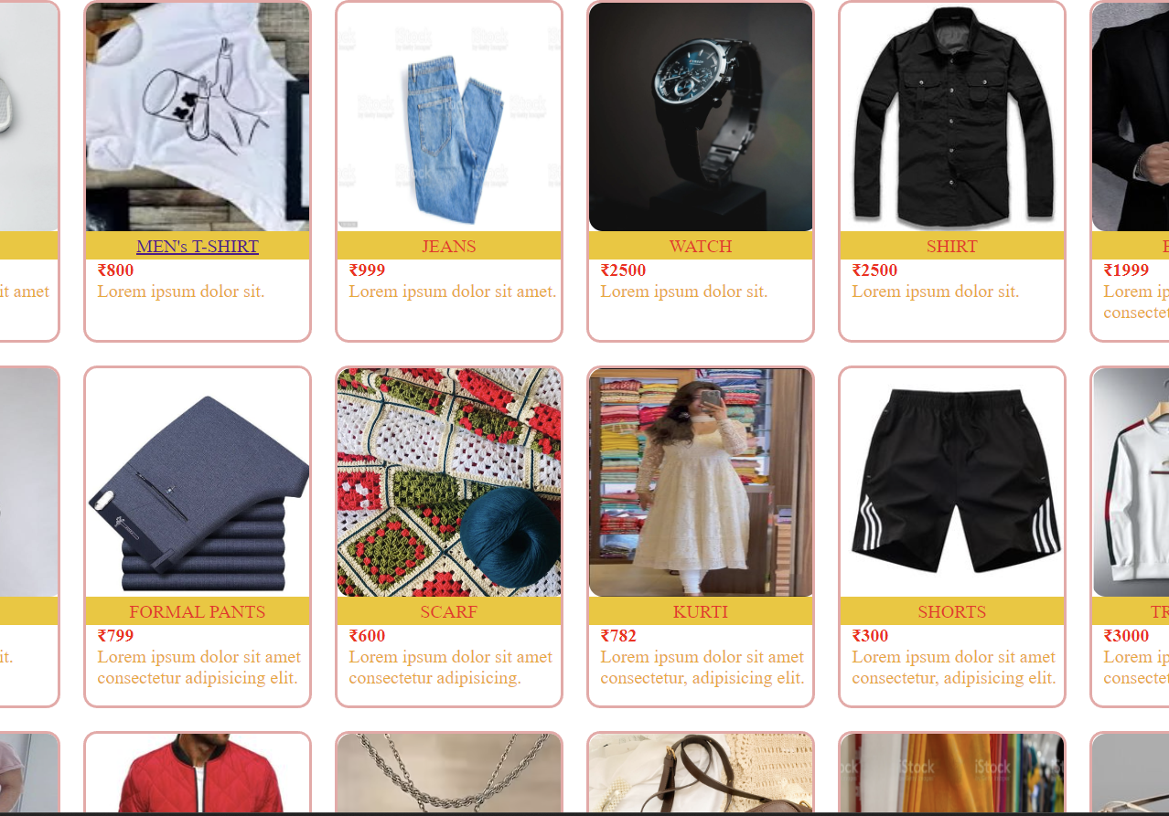
Introduction
The "Online E-commerce System" name “H&A” has been developed to override the problems prevailing in the practicing manual system. This software is supported to eliminate and in some cases reduce the hardships faced by this existing system. Moreover this system is designed for the particular need of the company to carry out operations in a smooth and effective manner.

Slide 5

Abstract of the Project Online E-commerce System:-
Abstract of the Project Online E-commerce System is the purpose of Online E-commerce System is to automate the existing manual system by the help of computerized equipment’s and full-fledged computer software, fulfilling their requirements

Slide 6
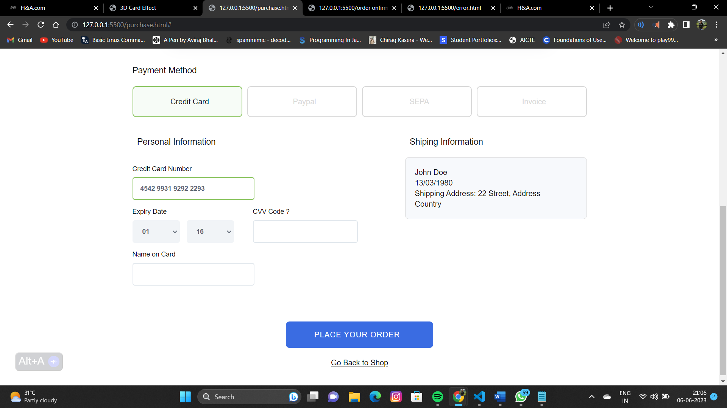
Objective
The main objective of the Project on Online E-commerce System is to manage the details of Clothes, Item Category, Shopping Cart, Customer, Order. It manages all the information about Clothes, Delivery Address, Order

Slide 7
Functionilities
.Product and Component based
• Creating & Changing Issues at ease
• Query Issue List to any depth
• Simple Status & Resolutions
• Multi-level Priorities & Severities.
• Attachments & Additional Comments for more information
• It contain better storage capacity.
• Accuracy in work.
• Easy & fast retrieval of information.

Slide 8

Project Requirement
Project Requirement:
- Hardware Requirements:
Processor required :- intel i3 or above
RAM required :- 2GB.
Tools & Technologies Used:
Tools (IDE): Visual Studio 2022
Code Behind: HTML, CSS ,Javascript

Slide 9

Name of Ecommerce Site:-

Slide 10

HOMEPAGE:-

Slide 11
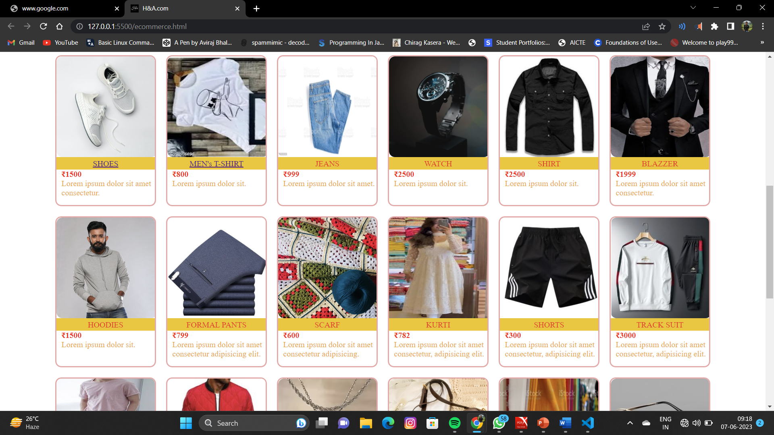
PRODUCT PAGE:-

Slide 12
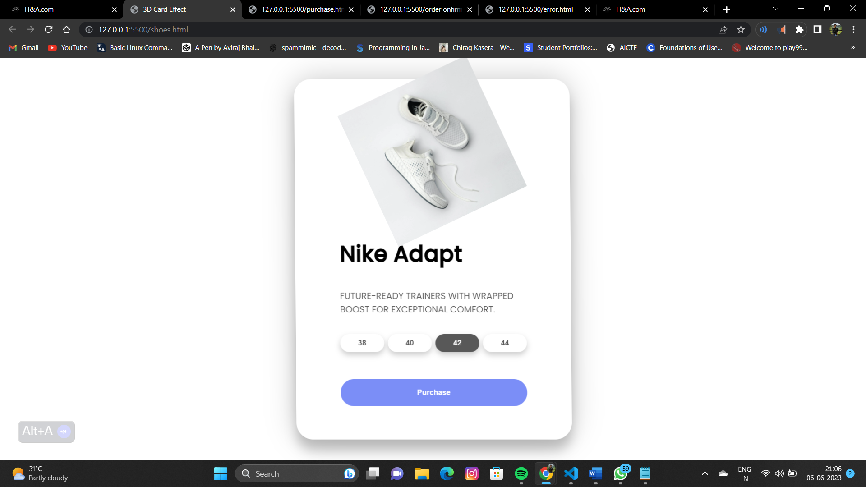
PRODUCT DETAIL:-

Slide 13
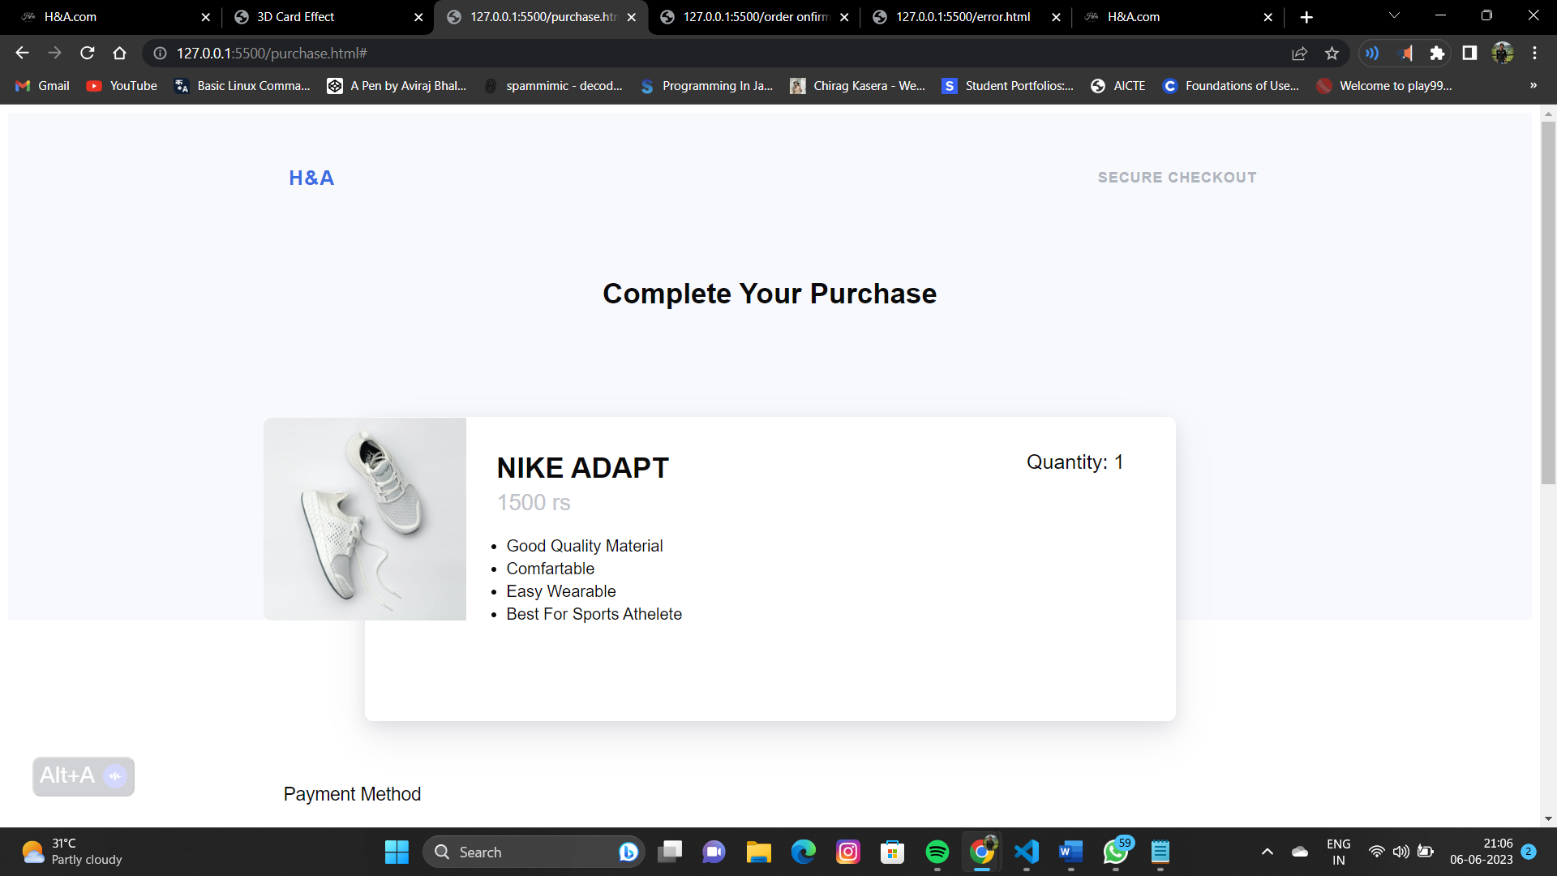
CHECKOUT :-

Slide 14
PAYMENT :-

Slide 15
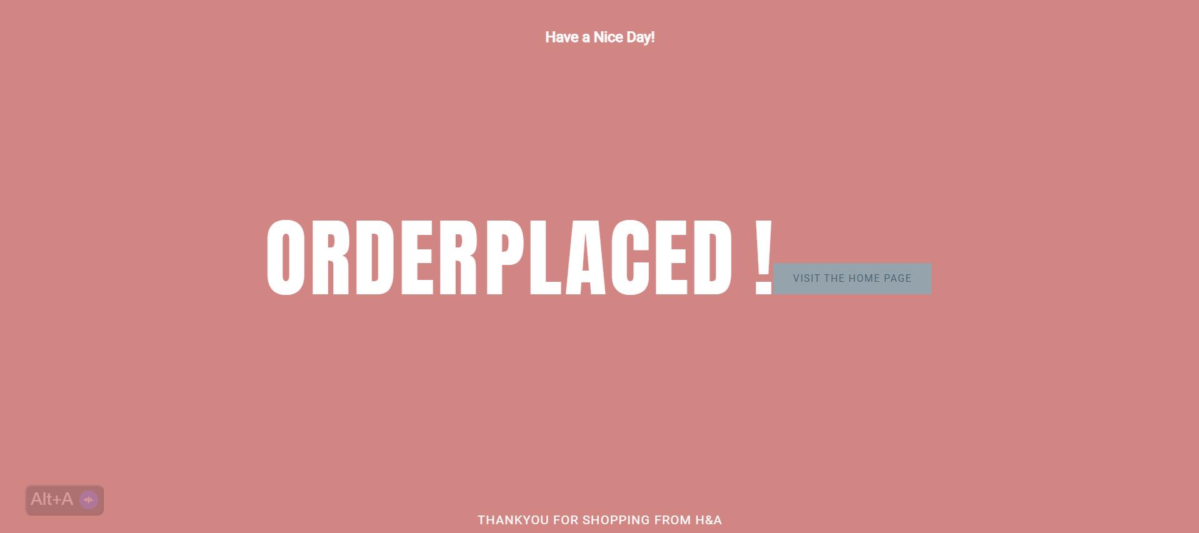
CONFIRMATION PAGE :-

Slide 16
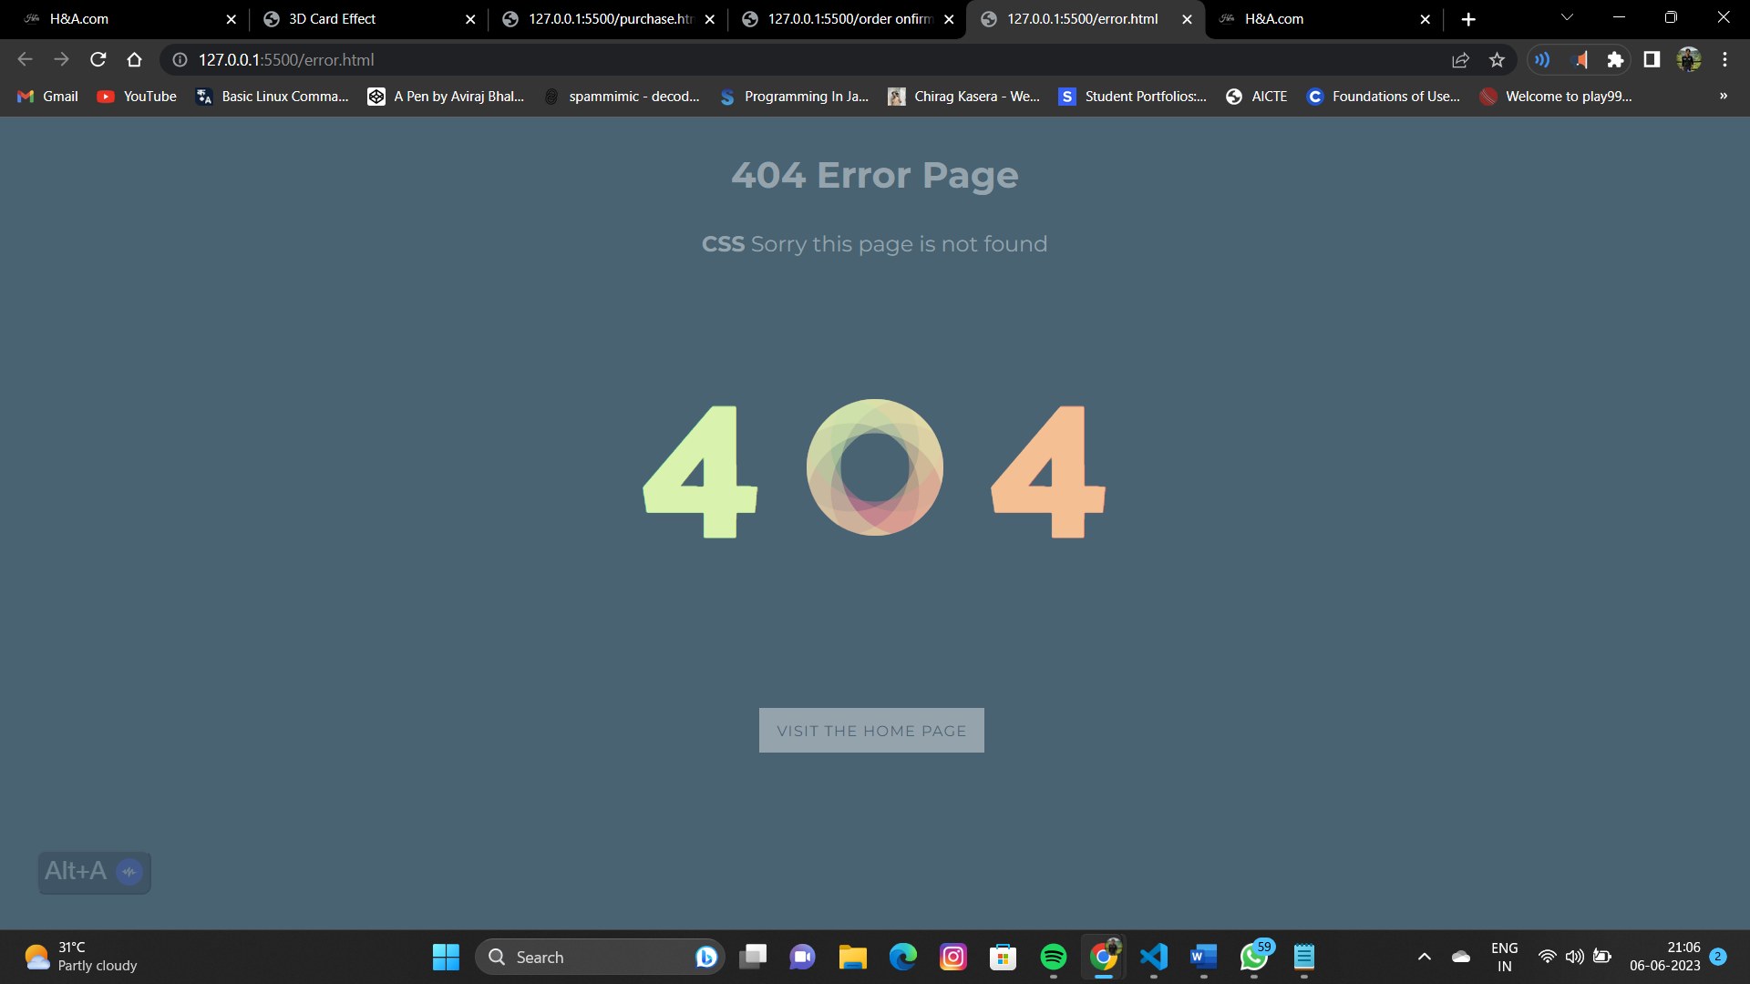
ERROR PAGE :-

Slide 17


Summary
It may help collecting perfect management in details. In a very short time, the collection will be obvious, simple and sensible. It will help a person to know the management of passed year perfectly and vividly. It also helps in current all works relative to Online E-commerce System.

Slide 18
Thank you
PRESENTED BY :-
Aviraj Bhaliya
21ADV3CSE0055
Harsh Deradi
21ADV3CSE0070
Gourav Chouhan
21ADV3CSE0066

